Slide 1
Object Oriented Testing

Slide 2
Objectives
To cover the strategies and tools associated with object oriented testing
  Analysis and Design Testing
  Class Tests
  Integration Tests
  System Tests
  Validation Tests
analysis
design
code
test

Slide 3
Strategic Issues
Issues to address for a successful software testing strategy:
  Specify product requirements in a quantifiable manner long before testing commences. For example, portability, maintainability, usability
  State testing objectives explicitly. For example, test coverage, etc
  Understand the users of the software and develop a profile for each user category. Use cases do this
  Develop a testing plan that emphasizes “rapid cycle testing”. Get quick feedback from a series of small incremental tests
  Build robust software that is designed to test itself. Exception handling and automated testing
  Conduct formal technical reviews to assess the test strategy and test cases themselves. “Who watches the watchers”
  Develop a continuous improvement approach to the testing process

Slide 4
What is a unit in an object oriented system?
What is a unit in an object orientated system?
  Traditional systems define a unit as the smallest component that can be compiled and executed
  Units are normally a component which in theory is only ever assigned to one programmer
Two options for selecting units in object orientated systems:
  Treat each class as a unit
  Treat each method within a class as a unit

Slide 5
Advantages for Object Orientated Unit Testing
Once a class is testing thoroughly it can be reused without being unit tested again
UML class state charts can help with selection of test cases for classes
Classes easily mirror units in traditional software testing

Slide 6
Disadvantages for Object Orientated Unit Testing
Classes obvious unit choice, but they can be large in some applications
Problems dealing with polymorphism and inheritance

Slide 7
Testing Analysis and Design
Syntactic correctness:
  Is UML notation used correctly?
Semantic correctness:
  Does the model reflect the real world problem?
  Is UML used as intended by its designers?
Testing for consistency:
  Are different views of the system in agreement?
  An inconsistent model has representations in one part that are not correctly reflected in other portions of the model

Slide 8
Testing the Class Model
Revisit the CRC model and the object-relationship model. Check that all collaborations are properly represented in both
Inspect the description of each CRC index card to determine if a delegated responsibility is part of the collaborator’s definition
  Example: in a point of sale system. A read credit card responsibility of a credit sale class is accomplished if satisfied by a credit card collaborator
Invert the connection to ensure that each collaborator that is asked for a service is receiving requests from a reasonable source
  Example: a credit card being asked for a purchase amount (a problem)

Slide 9
Final Steps in Testing the Class Model
Using the inverted connections examined in step 3, determine whether other classes might be required or whether responsibilities are properly grouped among the classes.
Determine whether widely requested responsibilities might be combined into a single responsibility
  Example: read credit card and get authorization could easily be grouped into validate credit request
Steps 1 to 5 are applied iteratively and repeatedly

Slide 10
Testing OO Code
class tests
integration
tests
system
tests
validation
tests

Slide 11
[1] Class Testing
Smallest testable unit is the encapsulated class
A single operation needs to be tested as part of a class hierarchy because its context of use may differ subtly
Class testing is the equivalent of unit testing in conventional software
Approach:
  Methods within the class are tested
  The state behavior of the class is examined
Unlike conventional unit testing which focuses on input-process-output, class testing focuses on designing sequences of methods to exercise the states of a class.

Slide 12



Class Testing Process
class
to be
tested
results
software
engineer
test cases

Slide 13
Class Test Case Design
Each test case should be uniquely identified and should be explicitly associated with the class to be tested
The purpose of the test should be stated
A list of testing steps should be developed for each test and should contain:
  A list of specified states for the object that is to be tested
  A list of messages and operations that will be exercised as a consequence of the test
  A list of exceptions that may occur as the object is tested
  A list of external conditions (i.e., changes in the environment external to the software that must exist in order to properly conduct the test)
  Supplementary information that will aid in understanding or implementing the test

Slide 14
Challenges of Class Testing
Encapsulation:
  Difficult to obtain a snapshot of a class without building extra methods which display the classes’ state
Inheritance:
  Each new context of use (subclass) requires re-testing because a method may be implemented differently (polymorphism).
  Other unaltered methods within the subclass may use the redefined method and need to be tested
White box tests:
  Basis path, condition, data flow and loop tests can all be applied to individual methods within a class but they don’t test interactions between methods

Slide 15
Composition Issues
Objective of OO is to facilitate easy code reuse in the form of classes
To allow this each class has to be rigorously unit tested
Due to classes potentially used in unforeseeable ways when composed in new systems
Classes must be created in a way promoting loose coupling and strong cohesion

Slide 16
Encapsulation Issues
Encapsulation requires that classes are only aware of their own properties, and are able to operate independently
If unit testing is performed well, the integration testing becomes more important
If you do not have access to source code then structural testing can be impossible
If you violate encapsulation for testing purposes, then the validity of test could be questionable

Slide 17
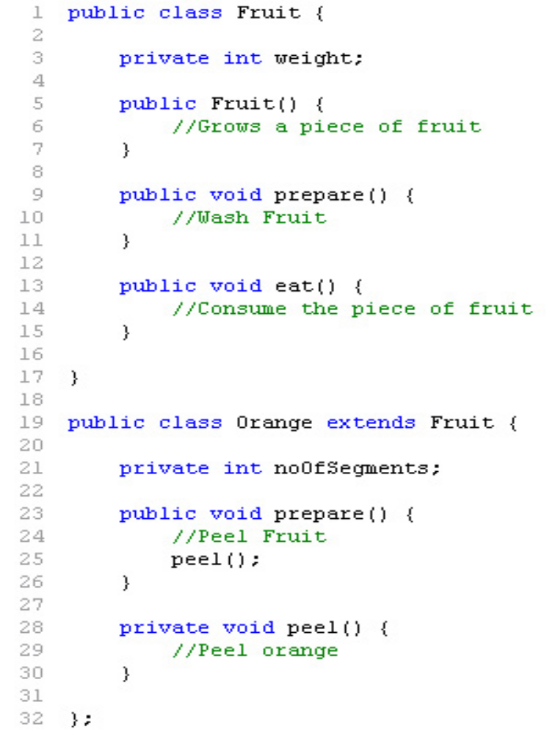
Inheritance Issues
Inheritance is an important part of the object oriented paradigm
Unit testing a class with a super class can be impossible to do without the super classes methods/variables

Slide 18
One Solution - Flattening
Merge the super class, and the class under test so all methods/variables are available
Solves initial unit test problems
Problems:
  The class won’t be flattened in the final product so potential issues may still arise
  Complicated when dealing with multiple inheritance

Slide 19
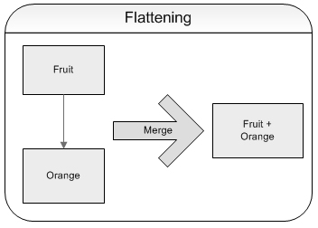
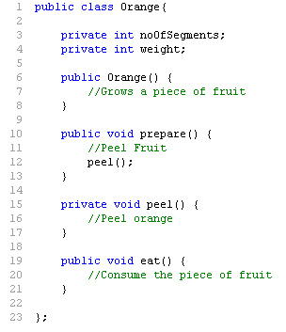
One Solution - Flattening

Slide 20
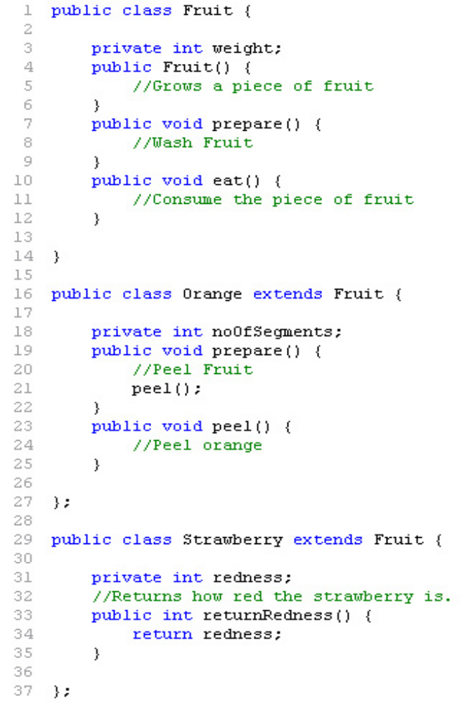
Polymorphism Issues
Repeatedly testing same methods
Time can then be wasted if not addressed
Potentially can be avoided, and actually save time

Slide 21
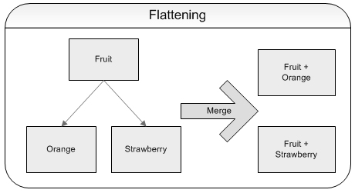
Polymorphism Issues

Slide 22
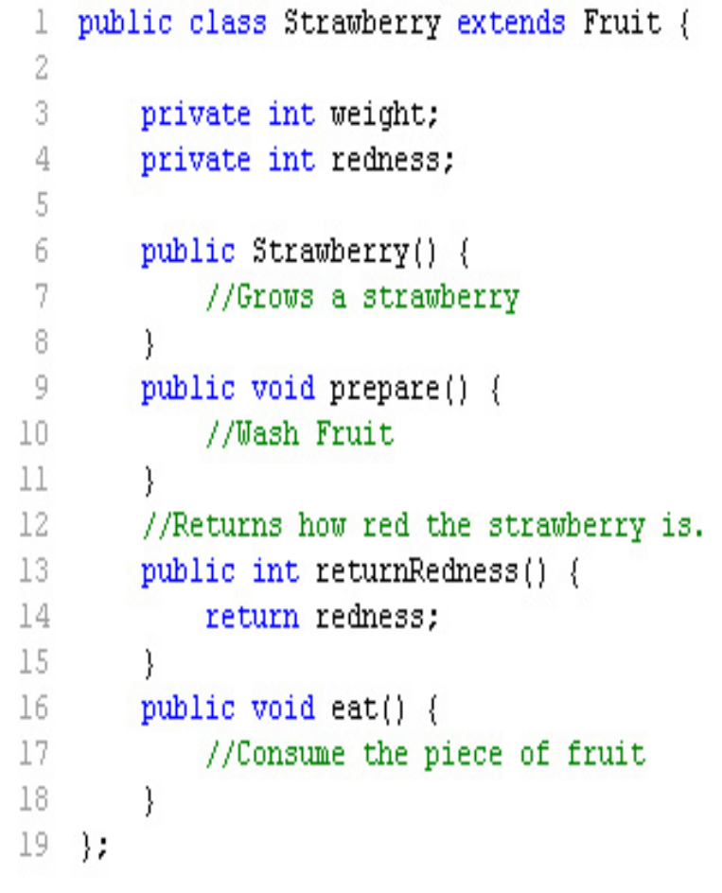
Polymorphism Issues - Example Code

Slide 23
Random Class Testing
Identify methods applicable to a class
Define constraints on their use – e.g. the class must always be initialized first
Identify a minimum test sequence – an operation sequence that defines the minimum life history of the class
Generate a variety of random (but valid) test sequences – this exercises more complex class instance life histories
Example:
  An account class in a banking application has open, setup, deposit, withdraw, balance, summarize and close methods
  The account must be opened first and closed on completion
  Open – setup – deposit – withdraw – close
  Open – setup – deposit –* [deposit | withdraw | balance | summarize] – withdraw – close. Generate random test sequences using this template

Slide 24
Partition Class Testing
Reduces the number of test cases required (similar to equivalence partitioning)
State-based partitioning
  Categorize and test methods separately based on their ability to change the state of a class
  Example: deposit and withdraw change state but balance does not
Attribute-based partitioning
  Categorize and test operations based on the attributes that they use
  Example: attributes balance and creditLimit can define partitions
Category-based partitioning
  Categorize and test operations based on the generic function each performs
  Example: initialization (open, setup), computation (deposit, withdraw), queries (balance, summarize), termination (close)

Slide 25
[2] Integration Testing
OO does not have a hierarchical control structure so conventional top-down and bottom-up integration tests have little meaning.
Class-as-unit, two steps must occur:
  If flattened classes are used , the original class hierarchy must be restored
  If test methods are added, they must be removed
Integration applied on various incremental strategies
  Client/Supplier Testing
  Thread based Testing
  Configuration based Testing
  Hybrid strategy

Slide 26
UML support for Integration Testing
Collaboration and Sequence Diagram are the basis for integration testing.
Collaboration diagram shows the message traffic among classes
Collaboration diagram supports both the pair-wise and neighborhood approaches to integration testing

Slide 27
Client/Supplier Integration Testing
The structure of client/supplier classes can be used to guide integration and done by users.
Steps –
  First, Integrate all servers, i.e. those objects which do not send messages to other application objects.
  Next, Integrate agents, i.e. those objects which send and receive messages.
  Finally, integrate all actors, i.e. application objects which send messages but do not receive them.

Slide 28
Thread Integration Testing
Also known as Use-based testing.
Integrates classes required by one use case
Each processing function is called a thread.
A collection of related threads is called a Build.
Builds serve as a basis for test management.
The addition of new threads for the product undergoing integration proceeds incrementally in a planned fashion.

Slide 29
Configuration Integration Testing
Implemented when there are many unique target environment configurations and for each configuration a unique build is required.
Example – In a distributed system, all or part of the application allocated to a particular node or processor. Here, the servers and actors are likely to encapsulate the physical interface to other nodes, processors, channels, etc.

Slide 30
Hybrid Strategy
A mix of top-down, bottom-up or big bang integration can be used.
Important Points –
  Perform complete class testing on actors and servers. Do limited bottom up integration.
  Do top-down development and integration of the high level control modules.
  Big bang the minimum software infrastructure: OS configuration, database initialization etc.
  Achieve a high coverage for infrastructure by functional and structural testing.

Slide 31
Levels of Object Oriented Integration Testing
One to integrate operations into a full class
One to integrate the class with other classes

Slide 32
Random Integration Testing
Multiple Class Random Testing
  For each client class, use the list of class methods to generate a series of random test sequences. The methods will send messages to other server classes
  For each message that is generated, determine the collaborating class and the corresponding method in the server object
  For each method in the server object (that has been invoked by messages sent from the client object), determine the messages that it transmits
  For each of the messages, determine the next level of methods that are invoked and incorporate these into the test sequence

Slide 33
Behavioral Integration Testing
Derive tests from the object-behavioral analysis model
Each state in a State diagram should be visited in a “breadth-first” fashion.
  Each test case should exercise a single transition
  When a new transition is being tested only previously tested transitions are used
  Each test case is designed around causing a specific transition
Example:
  A credit card can move between undefined, defined, submitted and approved states
  The first test case must test the transition out of the start state undefined and not any of the other later transitions

Slide 34
[3] Validation Testing
Are we building the right product? Validation succeeds when software functions in a manner that can be reasonably expected by the customer.
Focus on user-visible actions and user-recognizable outputs
Details of class connections disappear at this level
Apply:
  Use-case scenarios from the software requirements spec
  Black-box testing to create a deficiency list
  Acceptance tests through alpha (at developer’s site) and beta (at customer’s site) testing with actual customers

Slide 35
[4] System Testing
Software may be part of a larger system. This often leads to “finger pointing” by other system development teams
Finger pointing defence:
  Design error-handling paths that test external information
  Conduct a series of tests that simulate bad data
  Record the results of tests to use as evidence
Types of System Testing:
  Recovery testing: how well and quickly does the system recover from faults
  Security testing: verify that protection mechanisms built into the system will protect from unauthorized access (hackers, disgruntled employees, fraudsters)
  Stress testing: place abnormal load on the system
  Performance testing: investigate the run-time performance within the context of an integrated system

Slide 36
GUI Testing

Slide 37
What is GUI Testing
Graphical User Interface (GUI) Testing
Methods used to identify and conduct GUI tests, including the use of automated tools.

Slide 38
Elements of GUI Testing
A process
A GUI Test Plan
  Set test objectives
  Describe modules and associated GUIs to be tested.
  Generate Testing schedules.
  Compose Test Team
  Design test process/Create test case design specification
  Define test cases
  Create test procedures specification; execute test cases
  Evaluate GUI development tools platform
A set of supporting tools

Slide 39
GUIs Popularity
There are several reasons why GUIs have become so popular:
GUIs provide the standard look and feel of a client operating system.
GUIs are so flexible that they can be used in most application areas.
The GUI provides seamless integration of custom and package applications.
The user has a choice of using the keyboard or a mouse device.
The user has a more natural interface to applications: multiple windows can be visible simultaneously, so user understanding is improved.
The user is in control: screens can be accessed in the sequence the user wants at will.

Slide 40
GUI Test Strategy
Focus on errors to reduce the scope of tests
We intend to categorize errors into types and design test to detect each type of error in turn. In this way, we can focus the testing and eliminate duplication.
Separation of concerns (divide and conquer)
By focusing on particular types of error and designing test cases to detect those errors, we can break up the complex problem into a number of simpler ones.
Test design techniques where appropriate
Traditional black box test techniques that we would use to test forms based applications are still appropriate.
Layered and staged tests
We will organize the test types into a series of test stages. The principle here is that we bring tests of the lowest level of detail in components up front. We implement integration tests of components and test the integrated application last. In this way, we can build the testing up in trusted layers.
Test automation...wherever possible
Automation most often fails because of over-ambition. By splitting the test process into stages, we can seek and find opportunities to make use of automation where appropriate, rather than trying to use automation everywhere.

Slide 41
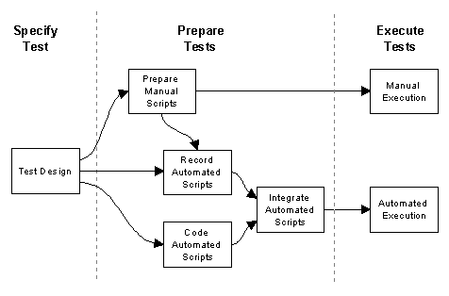
High Level Test Process

Slide 42
Types of GUI Errors
→ Data validation
Mishandling of server process failures
Wrong fields retrieved by queries
Field order
→ Multiple database rows returned, single row expected
Window object/DB field correspondence
Window system commands not available/don’t work
→ Correct window modality
→ Control state alignment with state of data in window
→ Focus on objects needing it
→ Menu options align with state of data or application mode
→ Action of menu commands aligns with state of data in window
→ Synchronization of window object content
State of controls aligns with state of data in window
Incorrect field defaults
Mandatory fields, not mandatory
Incorrect search criteria
Currency of data on screens

Slide 43
Stages of GUI Testing
We can map the four test stages to traditional test stages as follows:
→ Low level - maps to a unit test stage.
→ Application - maps to either a unit test or functional
system test stage.
→ Integration - maps to a functional system test stage.
→ Non-functional - maps to non-functional system test
stage.

Slide 44
Stages of GUI Testing
Low Level
→ Checklist testing
→ Navigation
Application
→ Equivalence Partitioning
→ Boundary Values
→ Decision Tables
→ State Transition Testing
Integration
→ Desktop Integration
→ C/S Communications
→ Synchronization
Non-Functional
→ Compatibility testing
→ Platform/environment

Slide 45
Old Approach Example (TRUMP)
Was Done by manually stepping through thousands of pages of test procedures.
Labor intensive, highly error prone.
Needed to be redone each time regression testing was required.
Very expensive.

Slide 46
Scripting
Another Programming Language.
Needs to be subjected to some form of formal verification.
Eliminates human error during execution of the test.
Can be used (sometimes with modifications) for regression testing.
Notes:
Test scripts are program written in a language that is used as the input to a front end for an automated testing tool. The testing tool must be able to take the test script and translate it into the appropriate data and command streams that are used to exercise the system in a way that achieves a satisfactory coverage.
The problem with test scripts is that they are programs just like the software being tested. They are subject to the same kind of errors that are found in any software system under test. A test script must therefore be itself the subject of some form of formal verification before it is used to formally verify the actual software under test.
Once a test script is ready to be used however, it eliminates the human error factor found in the manual execution of test procedures. It can be used in subsequent regression testing (after appropriate modifications in the case where the functionality being tested has changed).

Slide 47
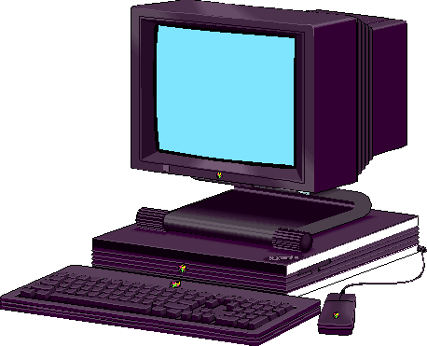


Scripting cont’d
Replay tool
Script

Slide 48
Capture/Replay Tools
A capture replay tool is a set of software programs that capture user inputs and stores it into a format (a script) suitable to be used at a later time to replay the user inputs.

Slide 49
Full Test Integration
Major drawback in Capture/Playback tool is that when the GUI changes, input sequences previously recorded may no longer be valid.
A test system which makes the maintenance of Capture/Playback generated test scripts easy and fast is a must for such a tool to be of any use.

Slide 50
Full Test Integration (cont’d)
A capture/playback tool that support the following capabilities could be used in a more capable and fully integrated test development environment:
  record scripts of user/system interactions
  user access to scripts for editing/maintenance
  user ability to insert validation commands in the script
  allows replay of the recorded script.

Slide 51
Full Test Integration (cont’d)
A fully integrated GUI test development environment would also require the following additional characteristics:
  Script editing using higher level abstractions such as icons etc.
  High level view of what functionality is being tested.
  The ability to generate many variations of a recorded script without having to manually edit the script itself.

Slide 52
Full Test Integration (cont’d)
A product called TDE under development by Siemens is to provide exactly this kind of functionality (currently only at the prototype level)

Slide 53
Full Test Integration (cont’d)
When the GUI changes, instead of editing the hundreds of generated test scripts, the editing is done at the scenario level where it is much easier and faster. This is followed by the automatic regeneration of the test scripts from the scenario.
TDE can detect and analyze the differences between a new GUI and its previous version. It then makes assumptions about the changes that can be subsequently overridden by the tester prior to script regeneration.
Notes:
An example of the kind of assumption TDE makes on changes, if a change was made by moving a menu item from one menu to another, but keeping the same name for the menu, TDE will assume that the item of the same name in the new location has the same functionality as the old item in the previous location.

